Slide 1
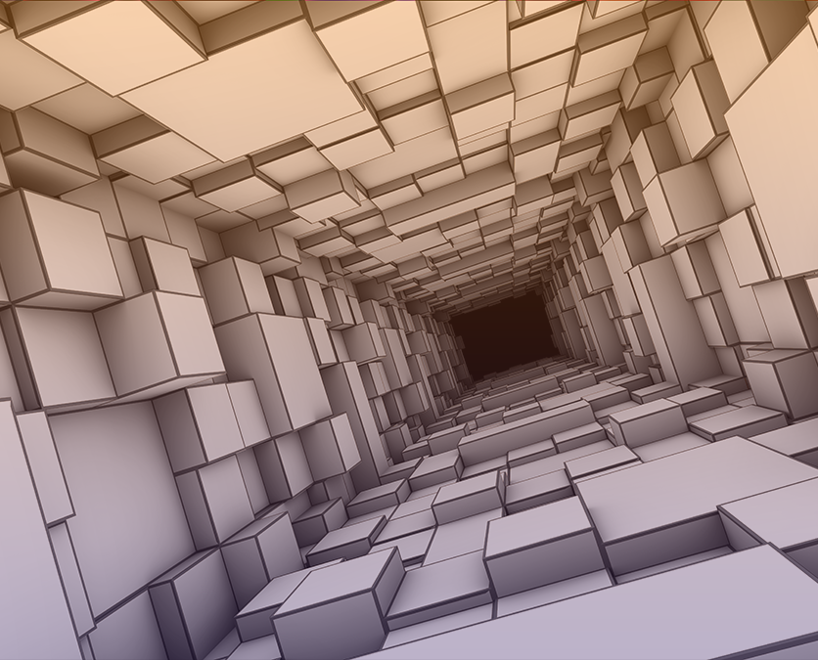
Compuertas lógicas
Ing. Mario López
Notes:
NOTE:
To change the image on this slide, select the picture and delete it. Then click the Pictures icon in the placeholder to insert your own image.

Slide 2

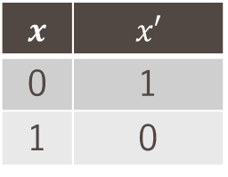


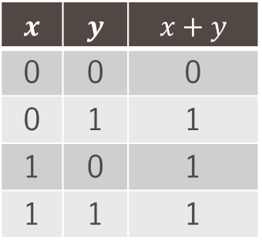




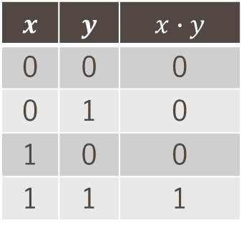

Compuertas lógicas
La compuertas lógicas más utilizadas son las siguientes: (1/3)
AND
OR
NOT
$$x$$ | $$y$$ | $$x∙y$$
0 | 0 | 0
0 | 1 | 0
1 | 0 | 0
1 | 1 | 1
$$x$$ | $$y$$ | $$x+y$$
0 | 0 | 0
0 | 1 | 1
1 | 0 | 1
1 | 1 | 1
$$x$$ | $$x′$$
0 | 1
1 | 0
$$x$$
$$x′$$
$$x$$
$$x$$
$$y$$
$$x∙y$$
$$y$$
$$x+y$$

Slide 3

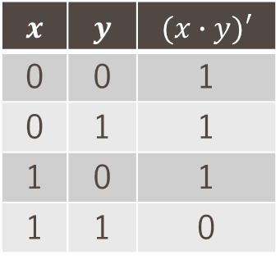

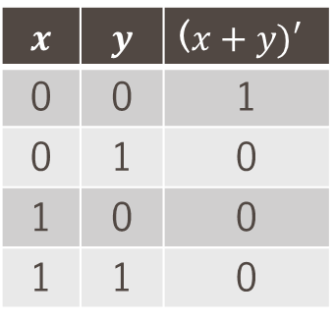




Compuertas lógicas
Continuación… (2/3)
NAND
NOR
$$x$$ | $$y$$ | $$(x∙y)′$$
0 | 0 | 1
0 | 1 | 1
1 | 0 | 1
1 | 1 | 0
$$x$$ | $$y$$ | ($x+y)′$
0 | 0 | 1
0 | 1 | 0
1 | 0 | 0
1 | 1 | 0
$$x$$
$$x$$
$$y$$
$$(x∙y)′$$
$$y$$
$$(x+y)′$$

Slide 4

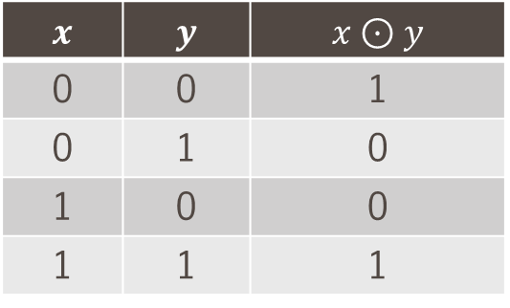


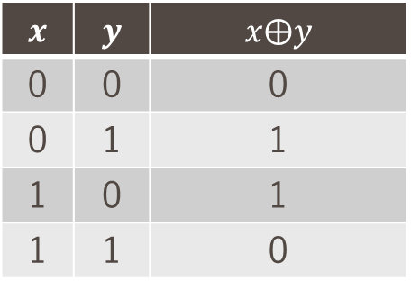






Compuertas lógicas
Continuación… (3/3)
XOR
XNOR
(Si y solo si)
$$x$$ | $$y$$ | $$x⨁y$$
0 | 0 | 0
0 | 1 | 1
1 | 0 | 1
1 | 1 | 0
$$x$$ | $$y$$ | $$x⊙y$$
0 | 0 | 1
0 | 1 | 0
1 | 0 | 0
1 | 1 | 1
$$x$$
$$x⨁y$$
$$(x⨀y)$$
$$x$$
$$y$$
$$(xy′+x′y)$$
$$y$$
$$(x⨁y)′$$
$$(xy+x′y′)$$

Slide 5
Muchas gracias
Ing. Mario lópez

